Slide 1
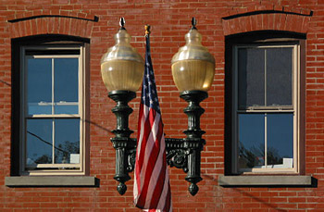
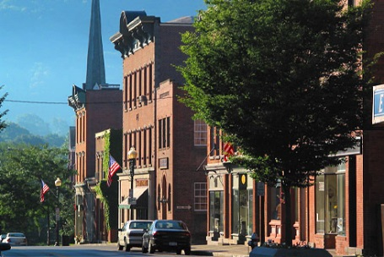
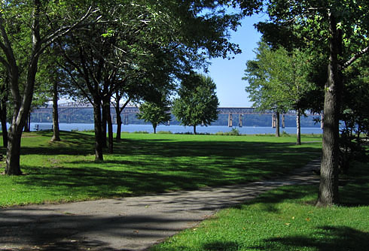
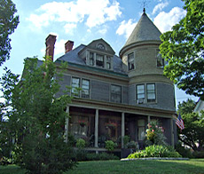
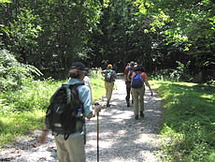
Beacon: A City Rich in History and Development
Author: Brian Young
Editor: Kaitlin Murphy
http://www.beacononhudson.com/

Slide 2
Beacon’s Origin
Dutchess County
The Dutch were the original claimers to the Dutchess County region.
Why did they settle in this region?
This area was a key location to develop a successful fur and pellet trading businesses.
http://fineartamerica.com/featured/dutch-fur-trade-granger.html

Slide 3
Transfer of Control
In 1863, the Dutch were forced to sell the state of New York, including Dutchess County, to the British.
Over time, the British gained a stronger control over the region as more immigrants moved to the area.
Why move to America?
Places like Dutchess County offered an opportunity of a fresh start for those that had been religiously and politically persecuted in Europe.
http://en.wikipedia.org/wiki/History_of_immigration_to_the_United_States

Slide 4
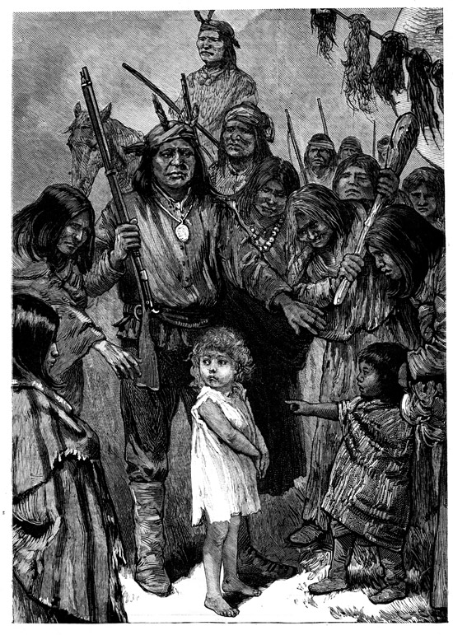
The Wappinger Tribe
What about the local Native Americans?
The specific group of Native Americans that lived in Dutchess County and the city of Beacon were known as the Wappinger.
After they were forced off their land, some assimilated into white culture or sought living quarters elsewhere.

Slide 5
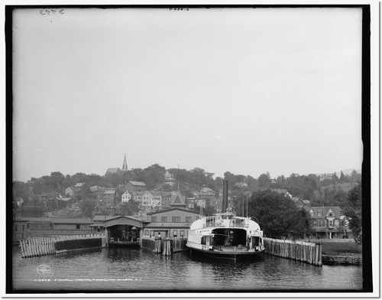
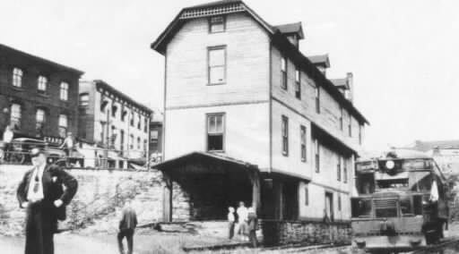
Beacon’s Development Into a City
Two Towns Merging Together:
Fishkill Landing
Matteawan
Beacon
http://www.encore-editions.com/fishkill-landing-fishkill-on-hudson-n-y
Fishkill Landing
http://www.kinglyheirs.com/CNE/NDCDutchess.html
Matteawan

Slide 6
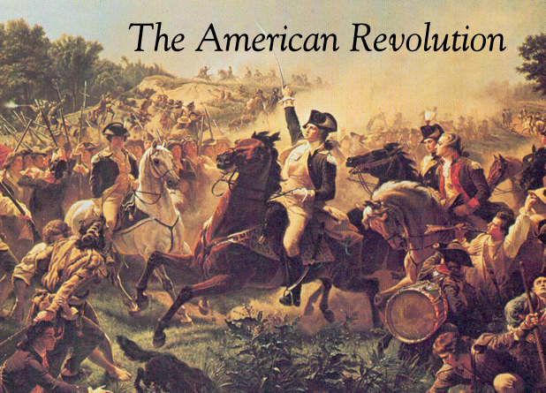
How Did Beacon Get its Name?
For the city’s role in the American Revolution!
During the American Revolution, the people of Beacon would light the tops of Mt. Beacon to warn the Americans of the location of British troops.
http://www.anexcellentspirit.com/category/2012-a-new-american-revolution/
Definition of Beacon: “a fire or light set up in a high or prominent position as a warning, signal, or celebration.
‘a chain of beacons carried the news’”
"Google." Google. N.p., n.d. Web. 12 Sept. 2013.

Slide 7
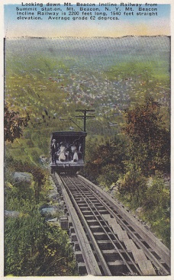
Mt. Beacon Incline Railway
Mt. Beacon not only served a purpose for the community during the American Revolution, but also as a communal local incline railway.
The railway open during the early 1900’s and gained popularity until the 1920’s.
It closed in the 1980’s due to repeated fires and is pending restoration.
http://transpressnz.blogspot.com/2011/07/mount-beacon-incline-railway-1905.html
http://www.cable-car-guy.com/html/ccarch.html
http://flickeflu.com/set/72157625688308216
http://www.midhudsonnews.com/News/2010/December/20/BeaInclRR-20Dec10.html

Slide 8
Newburg-Beacon Ferry
- First opened in 1743.
-Was used during the American War for Independence to provide a route of communication between the rebels and Congress.
-It had the most use before the Newburgh- Beacon Bridge was built.
-It was closed in 1963 but reopened in 2005.
http://en.wikipedia.org/wiki/Newburgh%E2%80%93Beacon_Ferry
http://en.wikipedia.org/wiki/Newburgh%E2%80%93Beacon_Ferry

Slide 9
Newburgh-Beacon Bridge
It opened in 1963.
There was an early demand for an expansion of the bridge because of its high usage.
The bridge’s expansion was completed in 1980.
http://www.hudsonvalley-love.com/2013_03_01_archive.html

Slide 10
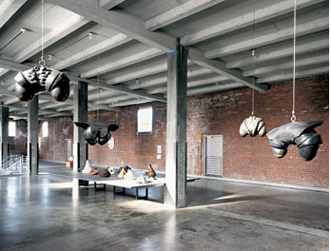
Dia: Beacon
is an art museum that opened in 2003.
It contains artwork that is meant to be shown to locals.
PURPOSE: help locals appreciate art and encourage the growth of the local culture.
http://www.diaart.org/exhibitions/main/122
http://www.diaart.org/exhibitions/main/78
http://www.diaart.org/exhibitions/main/87
http://www.diaart.org/exhibitions/main/88

