Slide 1
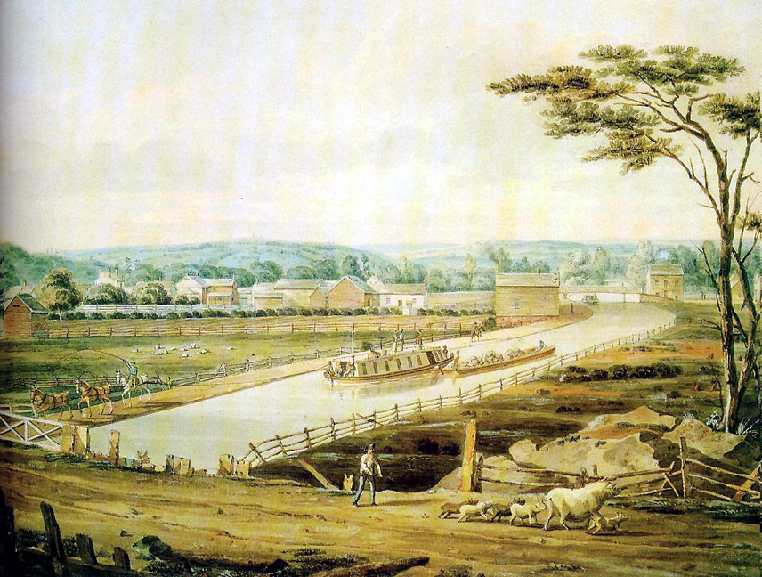
Erie Canal

Slide 2
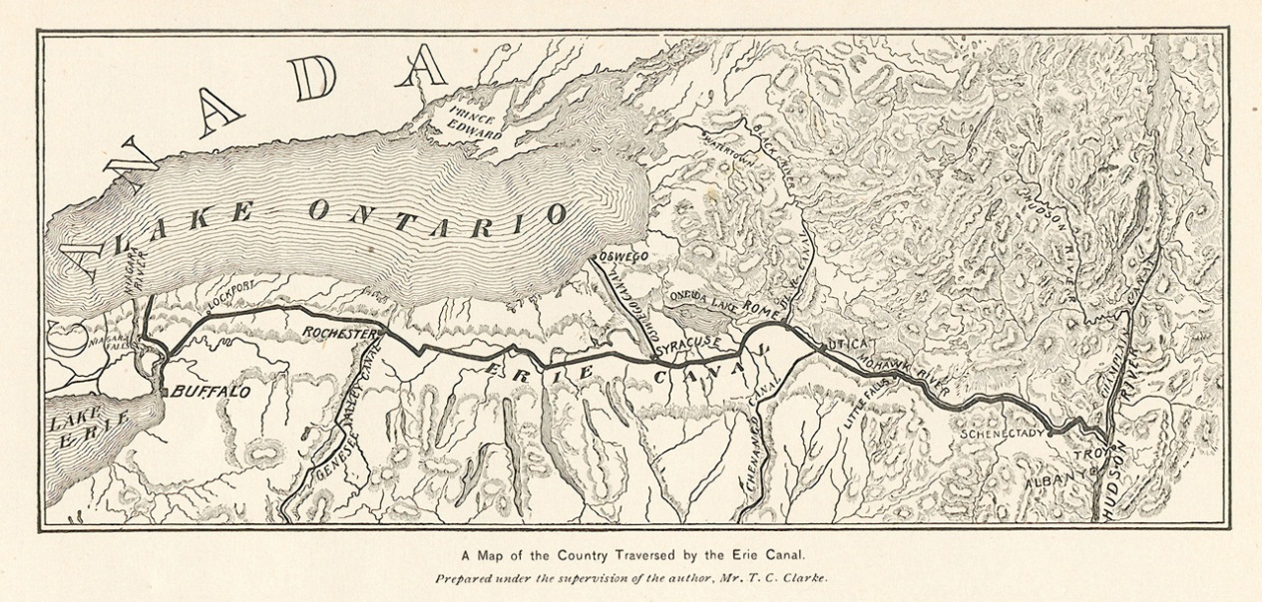
Background on the Canal
http://havefunwithhistory.com/movies/erie.html

Slide 3
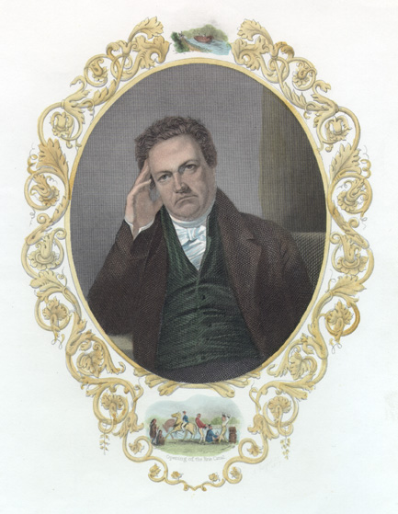
History
New York and Hudson River Valley needed a connection to the west
Governor DeWitt Clinton proposes canal
“The city will, in the course of time, become the granary of the world, the emporium of commerce, the seat of manufactures, the focus of great moneyed operations…And before the revolution of a century, the whole island of Manhattan, covered with inhabitants and replenished with a dense population, will constitute one vast city.”
Ridiculed by press and opposed by New York City and Ontario
Legislature allocates $7 million

Slide 4
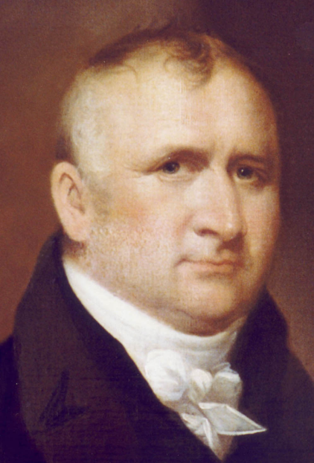
Architecture
No educated engineers were involved in the building (there were no engineering schools in the US at the time, but this project led to the development of such programs)
Benjamin Wright led a group of self-taught engineers
Relied on manpower and animal power

Slide 5
Architecture
Many contractors participated in the construction
Each contractor was responsible for digging a small section
Contractors had to supply their own equipment, labor force, and means of paying the laborers
Canvass White was able to overcome a challenge in the construction process
He learned how to create cement that would harden underwater using local cement
Led to reduction of costs because European cement no longer needed to be imported

Slide 6
Opening of the Canal
Once opened Governor Clinton travels on Seneca Chief from Buffalo to Albany
Emptied water from Great Lakes into ocean which symbolized “marriage of the waters”

Slide 7
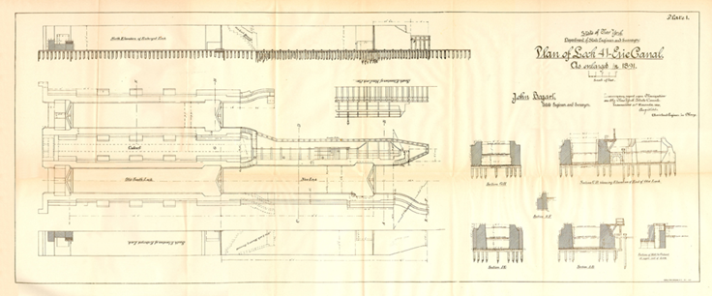
Locks
Lock 41, Fort Herkimer 1891
As the use of the canal increased, the locks had to change. Between 1836 and 1862, the locks increased to 110 feet long by 18 feet wide. They were also made to allow for traffic to flow in two different directions simultaneously. By 1870 they were 20 feet wide. By 1884 locks were able to handle two boats that were attached to each other (aka "double-headers“)
The original locks were 90 feet long and 15 feet wide. They could accommodate boats that were 61 feet long and 7 feet wide and had a 3 1/2 foot draft

Slide 8
Locks
Between 1903 and 1918, the “Barge Canal” was constructed. This led to locks that were 328 feet long, 45 feet wide, and 12 feet deep. This allowed for boats that were 300 feet long and 43.5 feet wide to successfully use the canal
1912

Slide 9
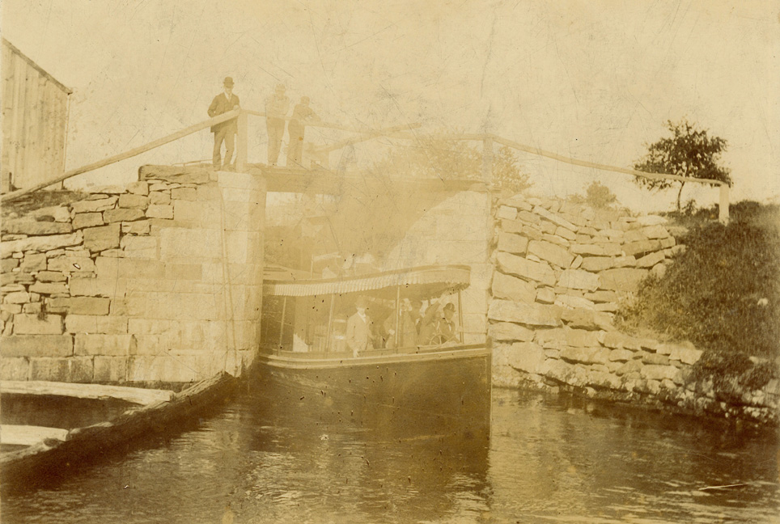
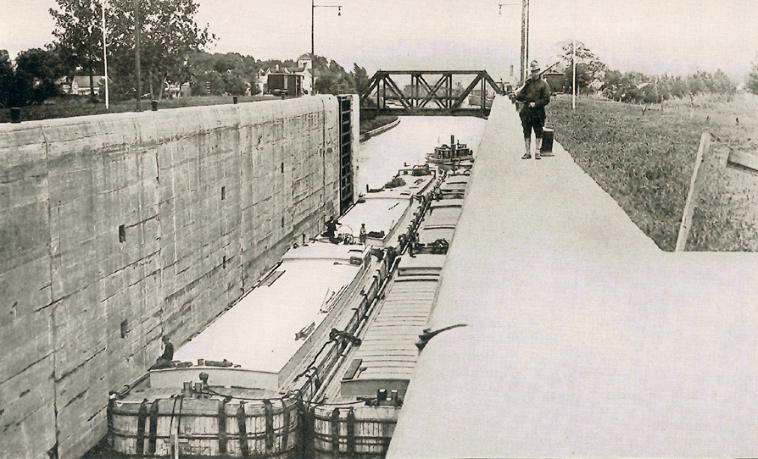
Locks
Approximately 1880
1919

Slide 10
Significance
Reduced travel
Travelling from Albany to Buffalo went from two weeks via stagecoach to five days via canal
Improved efficiency and cost
More goods could be carried by boats than could be carried by stagecoach
Costs to transport goods dropped from $100 per ton to $10 per ton

Slide 11
Significance
Increased immigration
Connected Eastern seaboard with the Great Lakes and the West
Availability of new resources and markets

Slide 12
Erie Canal: Then and Now

Slide 13
Additional Links/Museums
http://www.clcbm.org/
http://eriecanalcamillus.com/
http://eriecanalmuseum.org/
http://www.eriecanalway.org/

Slide 14
Bibliography
1sthydroace. "The Erie Canal - the Nation's First Superhighway - YouTube." YouTube - Broadcast Yourself. 26 Apr. 2010. Web. 31 Jan. 2012. <http://www.youtube.com/watch?v=oMz7eCj732w>.
"Benjamin Wright." The New York Marble Cemetery, Inc. Web. 31 Jan. 2012. http://www.marblecemetery.org/wrightb.htm.
"Erie Canal." Columbia Electronic Encyclopedia, 6Th Edition (2011): 1. Academic Search Elite. Web. 31 Jan. 2012.
"Erie Canal." Encyclopædia Britannica. Encyclopædia Britannica Online Academic Edition. Encyclopædia Britannica Inc., 2012. Web. 31 Jan. 2012. <http://www.britannica.com/EBchecked/topic/191438/Erie-Canal>.

Slide 15
Bibliography
"The Erie Canal: A Brief History." The New York State Canal System. Web. 23 Feb. 2010. <http://www.canals.ny.gov/cculture/history/index.html>.
"The Erie Canal: A Brief History." The New York State Canal System. Web. 31 Jan. 2012. <http://www.canals.ny.gov/cculture/history/index.html>.
"HFwH | The Erie Canal." U.S. History: Free Streaming History Videos & Activities. Web. 31 Jan. 2012. <http://havefunwithhistory.com/movies/erie.html>.
"Learn: History and Culture." Erie Canalway National Heritage Corridor. Web. 22 Feb. 2010. <http://www.eriecanalway.gov/learn_history-culture.htm>.

Slide 16
Bibliography
Sadowsky, Frank E. "New York State Canal System." The Erie Canal. Web. 22 Feb. 2010. <http://eriecanal.org/system.html>.
Sadowsky, Frank E. "New York State Canal System." The Erie Canal. Web. 31 Jan. 2012. <http://eriecanal.org/system.html>.

Slide 17
Pictorial Bibliography
"Erie Canal Images - Historical." The Erie Canal. Web. 03 Feb. 2012. <http://eriecanal.org/general-1.html>.
"Erie Canal - Locks." The Erie Canal. Web. 03 Feb. 2012. <http://eriecanal.org/locks.html>. nal.org/general-1.html>.
"Erie Canal - Maps." The Erie Canal. Web. 03 Feb. 2012. <http://eriecanal.org/maps.html>.

