Slide 1
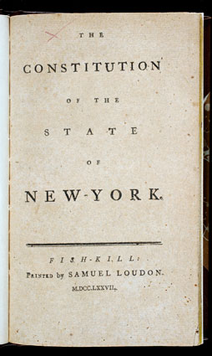
The New York State Constitution
Author: Brent Dukin
Editor: Kaitlin Murphy
http://states.phillipmartin.info/new_york/newyork_apple.html
https://www.nyhistory.org/web/crossroads/images/medium/constitution_ny_title.jpg

Slide 2
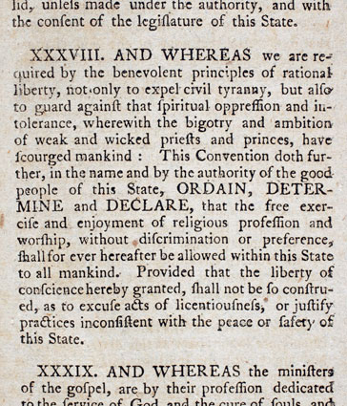
ADOPTION
New York’s first constitution was created and adopted in 1777.
Similar to the future U.S. Constitution, the NY Constitution contained both separation of powers and checks and balances.
When was the U.S. Constitution created?
1787
https://www.nyhistory.org/web/crossroads/gallery/all/constitution_ny_p31.html

Slide 3
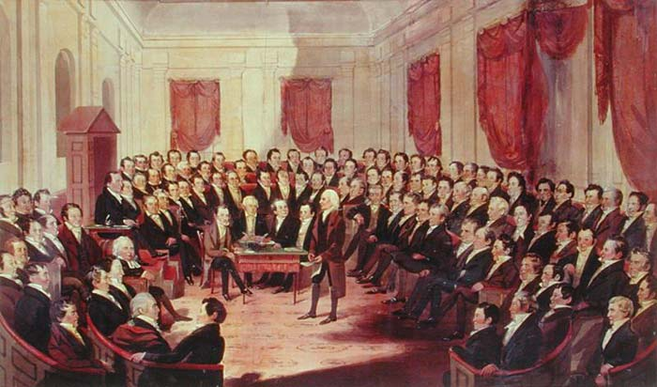
1821
The NY Constitutional Convention
A major topic at this convention was the suffrage of the growing number of freed slaves.
DECISION: Free African Americans were granted the right to vote as long as they met a certain property requirement.
PROBLEM: This requirement served to prevent most of the newly freed slaves from obtaining the right to vote.
http://arcweb.sos.state.or.us/pages/exhibits/1857/images/after/virginia.jpg

Slide 4
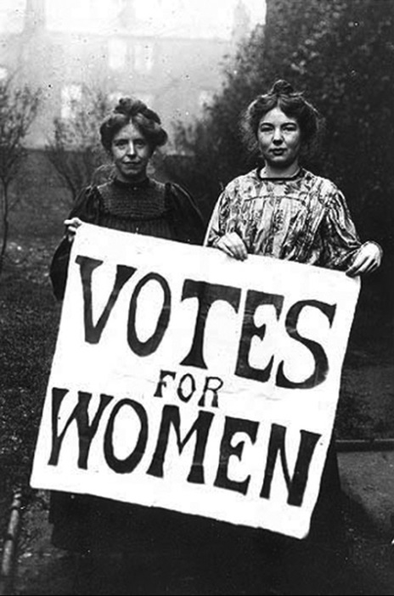
1846- The NY Constitutional Convention
What Happen?
A group of women met at the NY convention to petition for their right to vote.
Barrier: At the time, suffrage was considered solely a part of the male sphere.
Result: Woman were not granted suffrage. However, they began the process of questioning woman’s citizenship rights in New York.
http://www.public.navy.mil/airfor/nalo/Pages/Women'sEqualityDay.aspx

Slide 5
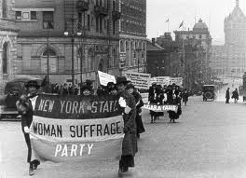
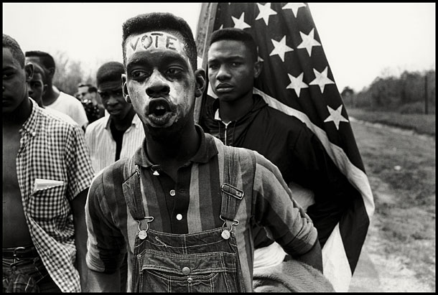
The New York Constitutional Convention
The Great Question: “Should blacks and women be granted the same voting rights as white men?”
Result: Both groups would not receive the right to vote until a later period.
Problem: At this time, African Americans and woman did not present a solid front because the relationships between their leaders had become strained.
http://www.altfg.com/blog/film-festivals/2009-festival-o
f-preservation-secret-beyond-the-door/
15th Amendment African Americans
20th Amendment women
1867
http://www.photography-collection.com/news/bruce-davidson-receives-world-photography-award/

Slide 6
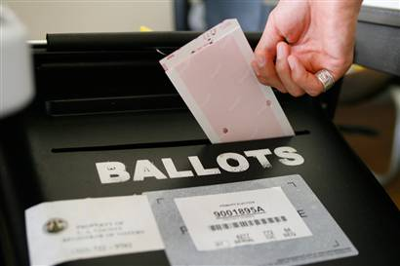
1997- New York Constitutional
Convention Vote
There is an article in the NY Constitution that requires that a question as to whether to hold a convention is automatically placed on the NY general ballot every twenty years.
This idea is based off the Jeffersonian view that it is healthy for a democracy to have each generation define anew their governing arrangements.
Thus, the issue at hand in 1997 was whether to approve holding a convention to consider and propose changes to the NY Constitution.
RESULT: voted down

Slide 7
Bibliography
Gerber, Scott D. "The Origins of an Independent
Judiciary in New York, 1621-1777." Social Philosophy & Policy 28 (2011): 179-201.
Newman, Richard. "Emancipating New York: The Politics of Slavery and Freedom, 1777-1827." The Journal of Southern History 74 (2008): 152-154
Garland, Libby. ""Irrespective of Race, Color Or Sex:" Susan B. Anthony and the New York State Constitutional Convention of 1867." Magazine of History 19 (2005): 61-64

Slide 8
Gerber, Scott D. "The Origins of an Independent Judiciary in New York, 1621-1777." Social Philosophy & Policy 28 (2011): 179-201.
Newman, Richard. "Emancipating New York: The Politics of Slavery and Freedom, 1777-1827." The Journal of Southern History 74 (2008): 152-154
Garland, Libby. "Irrespective of Race, Color Or Sex:" Susan B. Anthony and the New York State Constitutional Convention of 1867." Magazine of History 19 (2005): 61-64

