Slide 1
Construction of USS Monitor Impacts Upper-Hudson Valley
Andrew Mikolajczyk

Slide 2
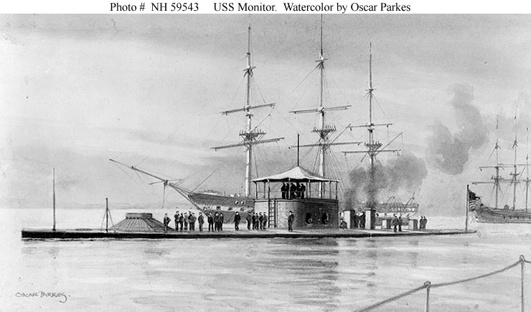
Thesis
New era of naval warfare would not have been possible if it wasn’t for the hard work and the dedication of Hudson Valley’s manufacturing. In addition, the building of the USS Monitor created a huge stimulation of economy within the Hudson Valley.

Slide 3
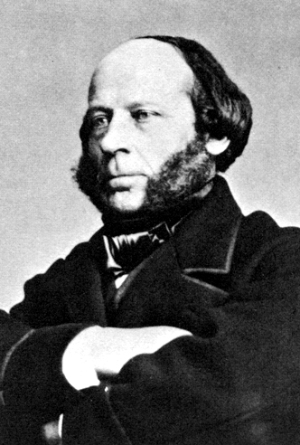
John Ericsson
Swedish inventor and designer, creator of the USS Monitor
Was a child prodigy, had designed Ironclad ships for France under Napoleon III but his designs were rejected
At 14, in Sweden, he had the title of surveyor for prominent canal builders, brought his ideas over with him to England in hopes to further the success of his steam engine design. He found that his design was not compatible with England as their engines used coal as a source of energy where his designs used the burning of wood.
The success of the USS Monitor led to Ericsson staying permanently in the Hudson Valley settling permanent residence in Rhinebeck NY

Slide 4
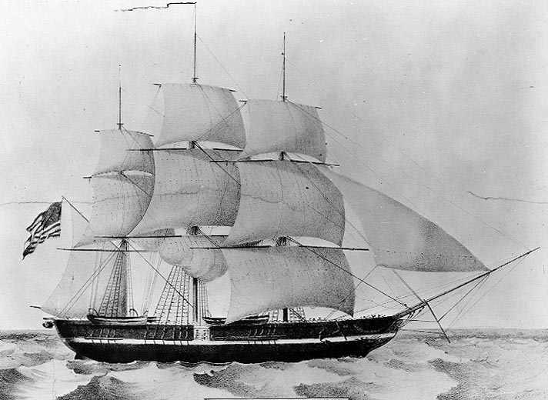
Could Ericsson be trusted?
His ideas were rejected by both England and France
Was recruited by the US Navy to design a propeller engine
Was brought on to help Robert Stockton with creating the USS Princeton
USS Princeton’s new cannon backfired; killing Secretary of State Abel Upshur and Naval Secretary Thomas Gilmer
Although it was Stockton’s fault for the cannons backfire, the Navy blamed Ericsson

Slide 5
Convincing the Navy
Rensselaer and Albany Iron Works pitched the design of the USS Monitor with John Ericsson to President Abraham Lincoln
Ericsson’s experience with iron ships designs in Europe made a big impression on the financiers
Cornelius Bushnell persuaded Troy’s steel manufacturers to get on board with Ericsson’s project; Bushnell used his pull to secure a letter of recommendation from the Governor of New York
The Navy still wasn’t convinced of Ericsson because of his history with the USS Princeton but having full endorsement of Abraham Lincoln, the USS Monitor began production in January of 1862

Slide 6
Economic Contributions to the Hudson Valley
Albany Iron Works built the deck plates, the hull skirt, and the angle iron for the frame
Rensselaer Iron Works made the rivets and the bar iron for the pilothouse
All of these companies promised that they could complete the task at hand in 100 days, something that hadn’t been done before up in the Hudson Valley
On top of creating the USS Monitor, the Hudson Valley produced 8 tons of steel a day to help the North in creating cannons
An innovation that brought a great deal of wealth to the Hudson Valley were “solid-lip railroad chairs” that were used to help repair many of the destroyed railroads in the border states of the Civil War, these were churned out by the thousands.

Slide 7
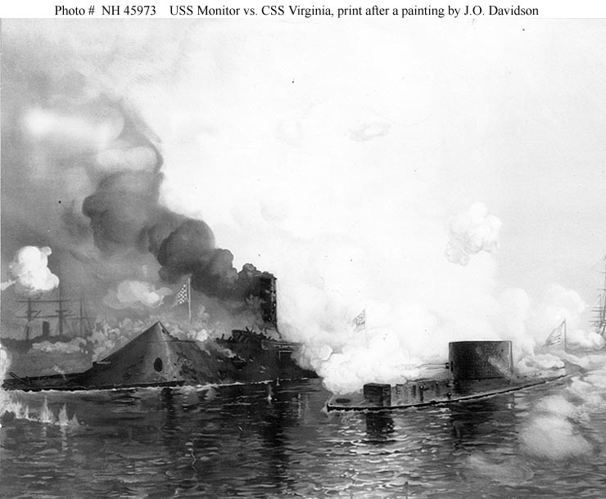
USS Monitor vs. CSS Virginia
March 8th 1862 naval warfare was changed forever as the USS Monitor and CSS Virginia battled
CSS Virginia was notorious for destroying the Union navy’s wooden ships, USS Cumberland and USS Congress
USS Monitor’s iron clad armor finally gave the CSS Virginia an even match
The USS Monitor came into the battle after the CSS Virginia had taken out USS Cumberland and USS Congress protecting the USS Minesota.
Battle quickly turned to USS Monitor vs CSS Virginia with the Monitor taking out Virgnia’s smokestack and the Virginia focusing on the Monitor’s pilothouse.

Slide 8
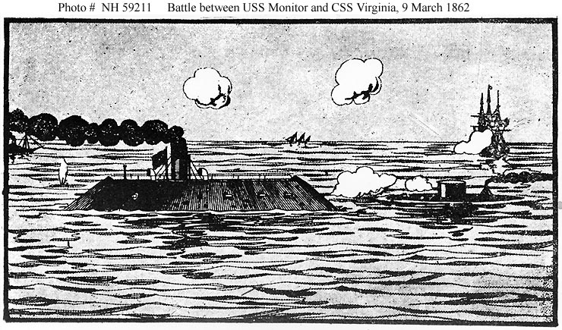
Retreat
The USS Monitor had to retreat after the Commanding Officer Lieutenant John Worden was blinded by a shell that hit the pilothouse
The USS Monitor was ready for battle again but the CSS Virginia had turned away and started retreating back to Norfolk, Virginia
The first modern naval battle had ended in a stalemate but it proved that the Union, with the help of the Hudson Valley, was ready for anything the Confederates wanted to attack with

Slide 9
Conclusion
On December 31st 1862 while traveling to the Carolina Coast to fortify a blockade, the USS Monitor hit inclement weather which led to its demise only eight months after being built
The USS Monitor was how the Union jumpstarted its way into modern naval warfare
Not only was the USS Monitor a contender against the South’s navy but was a major economic stimulator for the Hudson Valley

Slide 10
Monitor Today
The USS Monitor today sits in the Mariner’s Museum in Newport News, Virginia
On display are many artifacts recovered including her turret, cannon, propeller, anchor, and engine
Here is a short video on the present day Monitor exhibit: http://www.youtube.com/watch?v=_n-Qb9GZB4Q

Slide 11
Bibliography
Battle of the Monitor and Merrimack C.S.S Virginia Civil War Naval Battle. AmericanCivilWar.com. Retrieved January 30, 2012, http://americancivilwar.com/monitor.html
Don Rittner, Capital District Civil War Series #9: Troy’s Ironclad History.
USS Monitor has Rensselaer Ties: Rensselaer Magazine (Tory, New York 2002)
George Rogers Howell, Jonathan Tenney, Bi-centennial history of Albany: History of the county of Albany., Volume 2, pages 535-545.
Erastus Corning: Merchant and financier, 1794-1872 By Irene D. Neu 54.

